Slide 1
national assessment blueprinting
Islamic Studies Standardized Testing

Slide 2

Meeting Agenda
Deliver Brief Introductions
Analyze Program Needs
Review Research Process
Implement Assessment Blueprinting

Slide 3
ISST Members
SME
Dr. Tasneema Ghazi
Advisory Committee
Farisa Hussain
Select Experts:
National Educators
Major Schools
Islamic Scholars
Samana Khan
Habeeb Quadri
Program Coordinator
Lead Research
Coordinator
Partner Company
Measurement and Evaluation
Research
Coordinator
School Liaison

Slide 4
Needs Analysis
Common Trends
Teacher Defined
- Individualized Curriculum (alignment)
- Learning Objectives (transferability)
Curriculum
Teacher Certification
- Methodology
- Assessments
- Checks and Balance
Certification
Quality Education
- Data Proven Decision Making
- Stakeholders’ Concerns
Expectations

Slide 5
How do we resolve these issues?
National Procedures
National Guidelines
National Plan
Assure every child receives a fair and equal education.

Slide 6
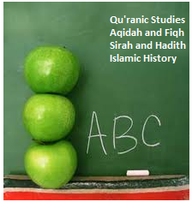

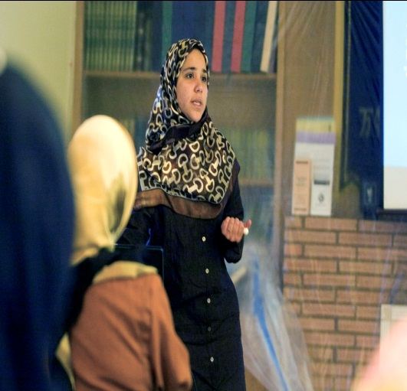
Research Process: Islamic Standards
Schools
✓Approached
Major Schools
✓Gathered
Curricula
✓Charted Commonalities
Textbooks
Educators
✓Selected Panel Members
✓Researched
Textbooks
✓I Love Islam
IQRA’
Good Word
✓Charted Commonalities
✓Pilot Test
✓Experts Revise Standards
✓Incorporate Feedback
✓Develop Accepted Standards

Slide 7

What is the most effective way to evaluate student mastery of national standards?
Develop National Assessments
Islamic Curriculum should require Standardized Tests
Similar to
ITBS
Stanford
Terra Nova

Slide 8
Purpose of Today’s Meeting
BLUEPRINTING
  Weight Each Subject
1
  Rank Standards
2
Rank the Competencies
  Rank Competencies
3
  Develop Items for Ranked Competencies
4

Slide 9
  Weight Each Subject
1
- Memorizing
- Understanding
- Applying Concepts
- Study of Islamic
laws, practices,
and basic beliefs
- Detailed study of
Rasulullah (s)’ life
- Study of his actions and sayings
- Study of Prophets’
history and Islamic
geography
Qur’anic
Studies
Aqidah
Fiqh, Akhlaq
Sirah and Hadith
Islamic
History
25%
25%
25%
25%
Islamic Studies Subjects

Slide 10
  Weight Each Subject
1
2nd Grade
5th Grade

Slide 11
  Rank Standards
2
Follow along on handout

Slide 13
  Rank Competencies
3
Follow along on handout

Slide 14
  Develop Items for Ranked Competencies
4
Item Writing Training
Setup a Question Bank
  (Details to follow in Email)

Slide 15
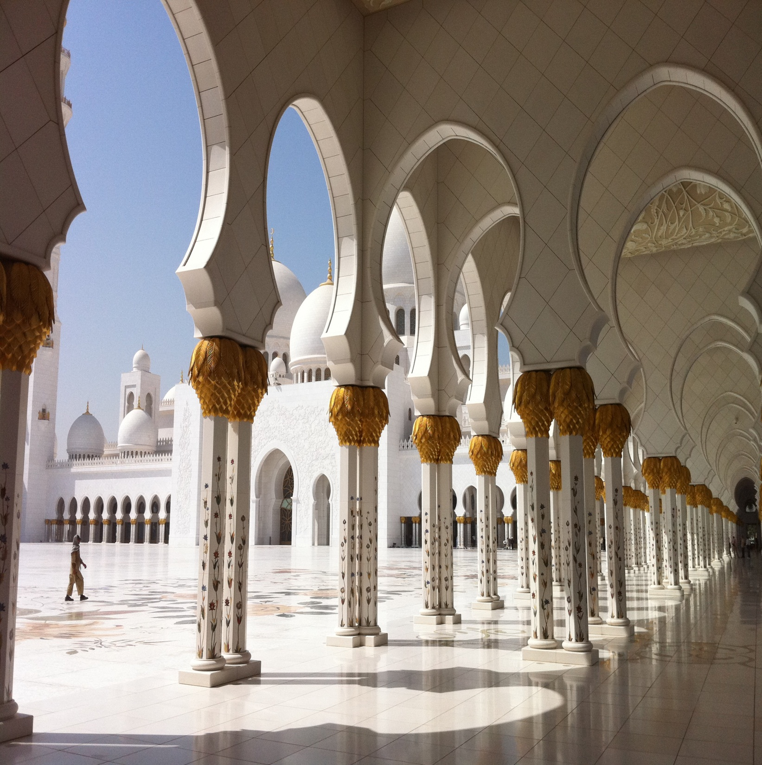
Islamic Studies Standardized Testing
Jaza’kullah Khair

