Slide 1
Islamic studies standardized tests
I
S
S
T
Road to Success

Slide 2
What is the ISST?
A national assessment program designed to provide schools with valuable data on a student’s ability to master concepts within four major subjects:
Quran’ic Studies
Aqidah, Fiqh and Akhlaq
Sirah and Hadith
Islamic History
Tests are based on the National Islamic Studies Standards (NISS)
developed by a committee of Islamic scholars, professors, certified teachers, principals (from across the U.S.)
NISS outlines what is important and appropriate for children to know at each grade level

Slide 3
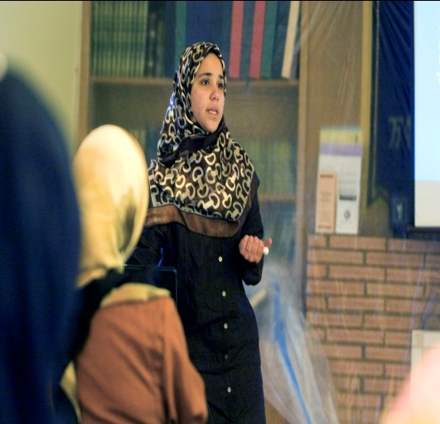
Research Process: Curriculum Standards
Schools
✓Approached
Major Schools
✓Gathered
Curricula
✓Charted Commonalities
Textbooks
Educators
✓Selected Panel Members
✓Researched
Textbooks
✓I Love Islam
IQRA’
Good Word
✓Charted Commonalities
✓Developed Accepted Standards
✓Experts Revise Standards
✓Incorporate Feedback
✓Developed National Assessment

Slide 4
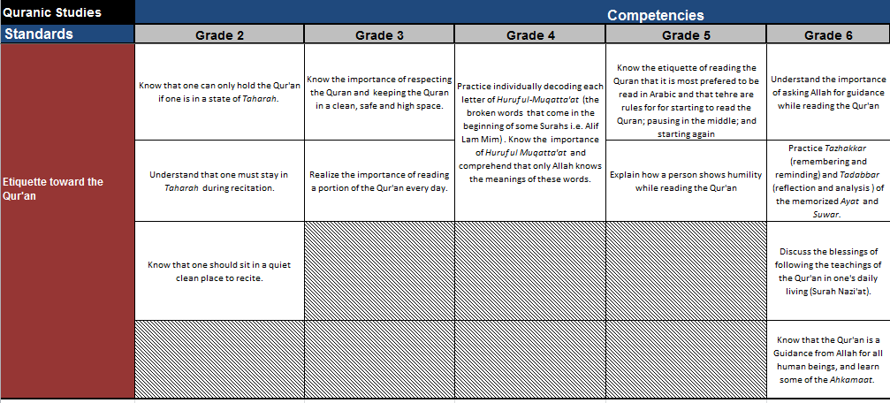
Sample Curriculum Standards (NISS)

Slide 5
Quick Facts
Test is criterion-referenced
Designed and developed by Islamic Educators
working in Islamic school system
Test is national and encompasses nationally
recognized curricula of major Islamic Schools
in North America
Questions derived from standards designed
for each grade and subsequent content

Slide 6
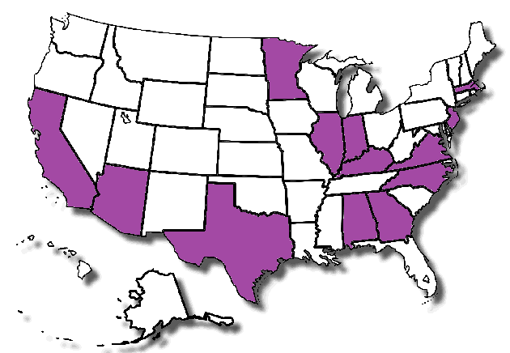
More Quick Facts
Tests have been piloted in major Islamic schools across North America
Over 40 Islamic schools across the nation utilize the tests with additional schools adopting the test every year

Slide 7
Test Validity I
Test questions evaluated by Dr. John Wick
Northwestern University Professor
Published Extensively in areas of:
psychometric, measurements, statistics, and school improvement
Former Director of Research and Development
Chicago Public Schools and North Central Association
Dr. Wick assessed that the Test is:
“Well designed and highly effective in subjectively measuring individual student achievement relative to set learning standards”

Slide 8
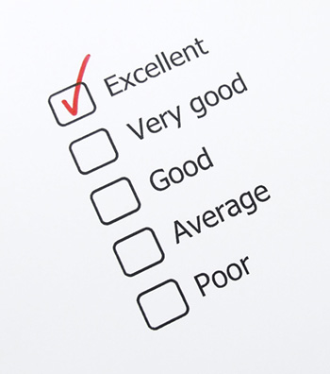
Test Validity II
Additionally evaluated by Dr. Denis Jarvinen
Ph.D. in Educational Psychology specializing in Measurement and Evaluation
Founder and president of Strategic Measurement and Evaluation (SME)
Award winning educator with over twenty years of experience in assessment development and data analysis
Recognized authority on facilitating test development and serves as the company’s primary psychometrician

Slide 9
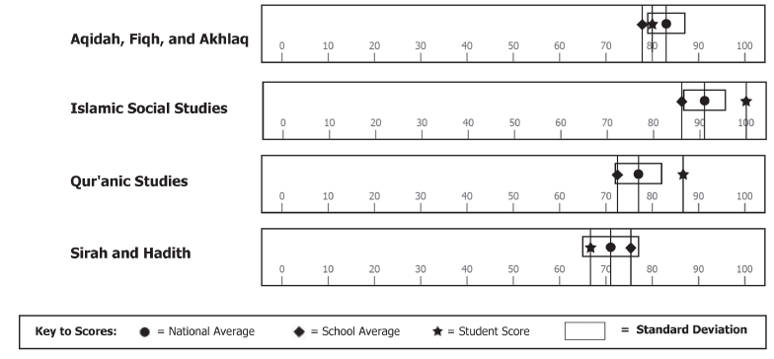
How Tests are Scored
Scoring is conducted by SME
- a partner of Riverside Publishing
Scores are reported in
Percent Correct
National Averages
Percentile Ranking
Participating Schools will Receive
Building Report
Class Summary
Individual Student Report
Test results are private and confidential
- Results will not be shared with other schools

Slide 10
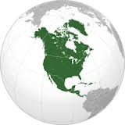
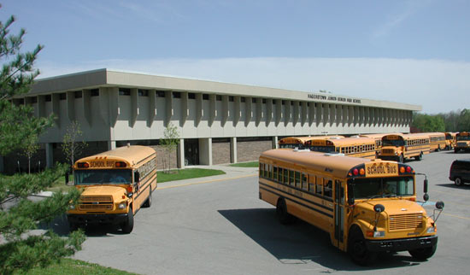
Benefits of the Tests
National
Unite Islamic Schools across North America
School
Evaluate Curriculum Effectiveness
Student
Recognize need for Student Enrichment
Establish a more Challenging and Meaningful Standard for Islamic Curricula
Measure Student Achievement
Track Student Progress
Assess Instructional Methods and Best Practice
Use Program as Marketing Tool for the School
Recognize need for Student Remediation

Slide 11
Who is Eligible to Take the Tests?
Students from Grades 2 thru 8

Slide 12
Scheduling Testing
Optimal Testing Time: Between March - May

Slide 13
Using Data From Tests
Determine areas for remediation or enrichment
Gain insights on program effectiveness

Slide 14
How Can Schools Participate
Visit www.iqrafoundation.com to view National Standards
Order materials and scoring from SME
Add testing dates to school calendar
Train faculty for accurate test administration
Interpret, share, and apply data
Complete SME Order Form
Fax to 217-355-0379
or Call 877-782-8269
Strategic Measurement and Evaluation, Inc
ATTN: Islamic Studies Standardized Test Services
701 Devonshire Drive, Suite B-14
Champaign, Illinois 61820

